Slide 1

North Western University, Khulna Tuition Management System
1
Course Title: Software Development Sessional III
Course Code: CSE-3204

Slide 2



Team NWU_TMS
2
Raihanul Islam Apu
Student ID: 20201133010
Department of CSE
North Western University, Khulna
Anisha Akter
Student ID: 20201119010
Department of CSE
North Western University, Khulna
MD Shahed Afridi
Student ID: 20201134010
Department of CSE
North Western University, Khulna

Slide 3
Overview
3
Introduction
Objectives
ER-Diagram
Site Tree
System homepage
List of Student page
Find Teacher page
Admin login page
Admin page
Block user page
Student login page
Student profile
Teacher login page
Teacher profile
Dependencies

Slide 4
Introduction
4
Tuition Management System (TMS) is a software where students find their private tutor and teachers find students for tuition.
This software is built in the Python language and uses Python Tkinter standard GUI library.
In this software, students choose their teacher. After taking lessons, they can rate their teacher. So, other students can learn about a teacher before fixing for his private tutor.

Slide 5
Objectives
5
Eliminate the difficulties to find.
Simplify to search.
Review facilities.
Digital Interface.
Block System
Managing multiple users.
Store student and teachers data.

Slide 6
Entity Relationship Diagram
6
Figure: ER-Diagram of Tuition Management System

Slide 7
Site Tree
7
Tuition Management System
Home
Here we can see Admin Student and Teacher character have their own functions.
Admin
Teacher
Student
Show Student
Show Student
Block a user
Show Teacher
Show Teacher
Add new admin
My Account
My Account
Review
Review

Slide 8
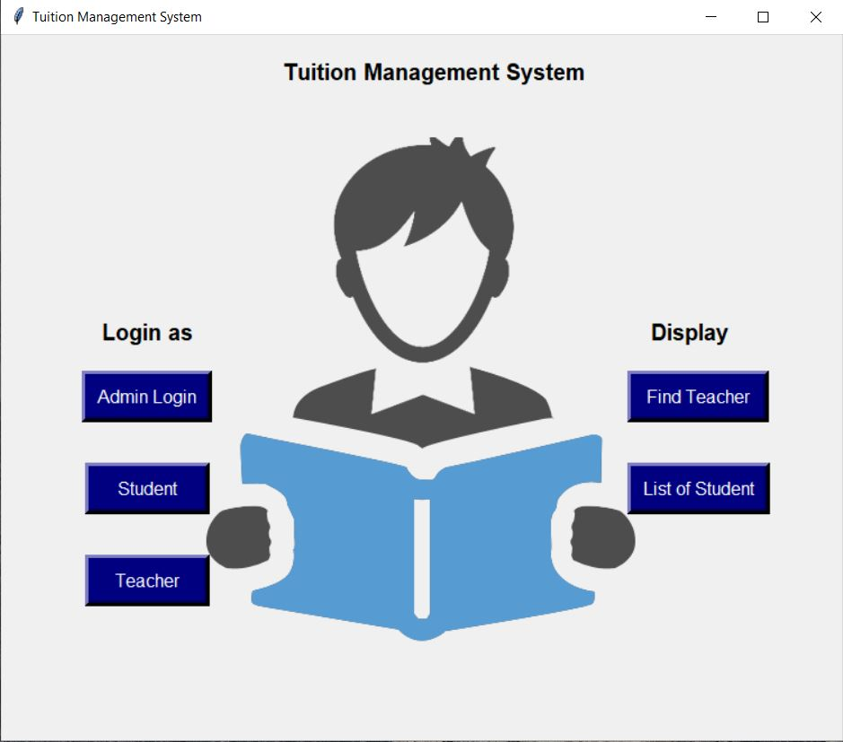
System Home Page
8
Home page view
Have 5 buttons
2 sections- Login and Display

Slide 9
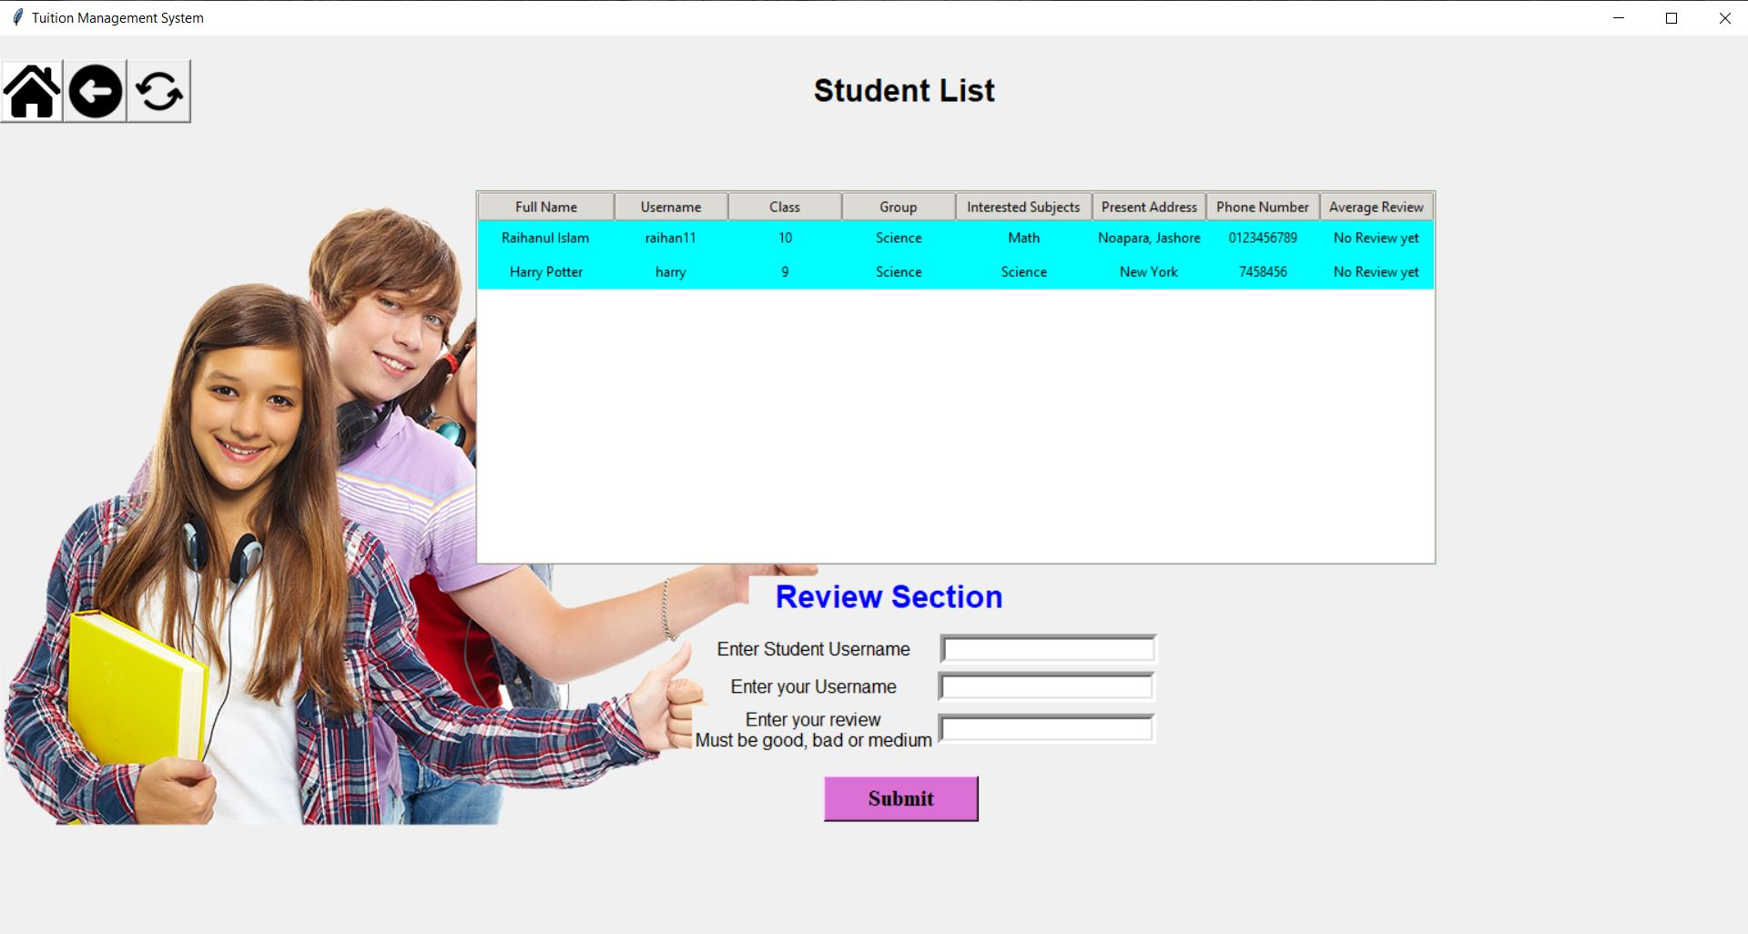
List of students Page
9
After click on Student list button
Showing Student list
Only Registered teachers can give reviews

Slide 10
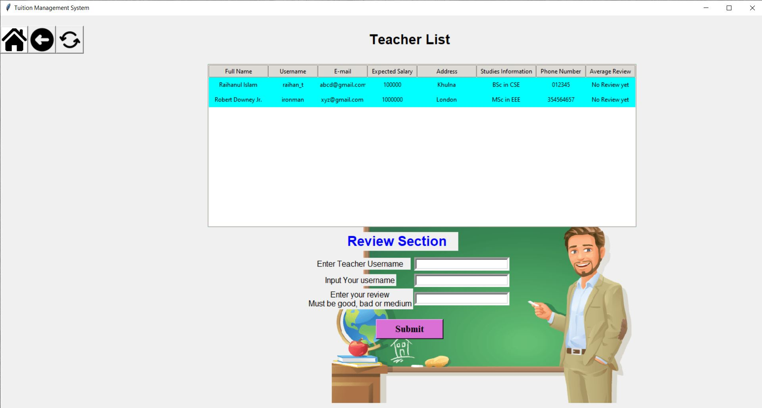
Find Teachers Page
10
After click on Find teacher button
Showing teachers list
Only Registered students can give reviews

Slide 11
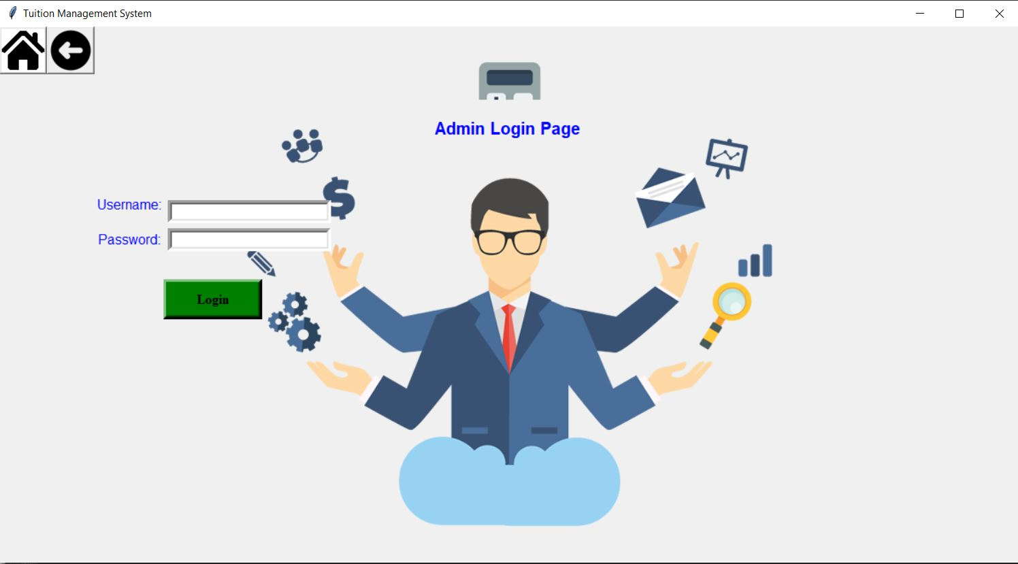
Admin login page
11
After click on Admin button
Input username and password to login

Slide 12
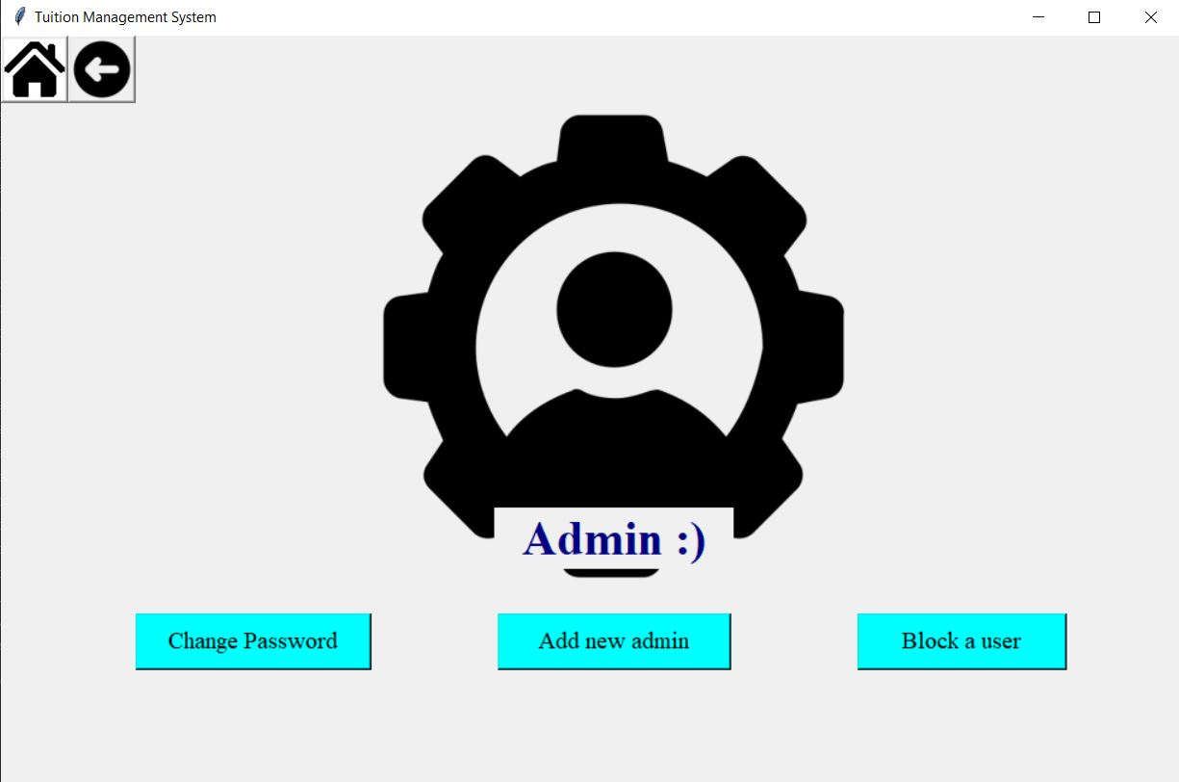
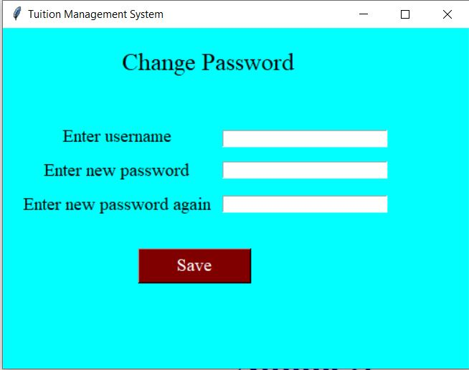
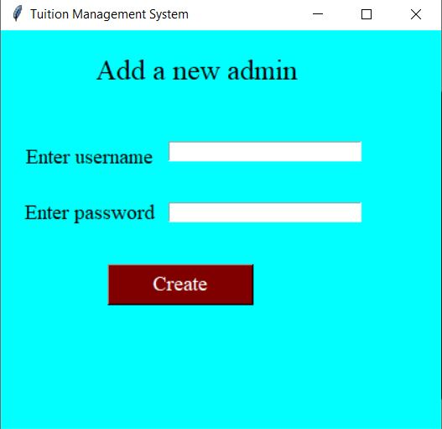
Admin Page
12
After admin login
Change Password
Add new admin
Block a user

Slide 13
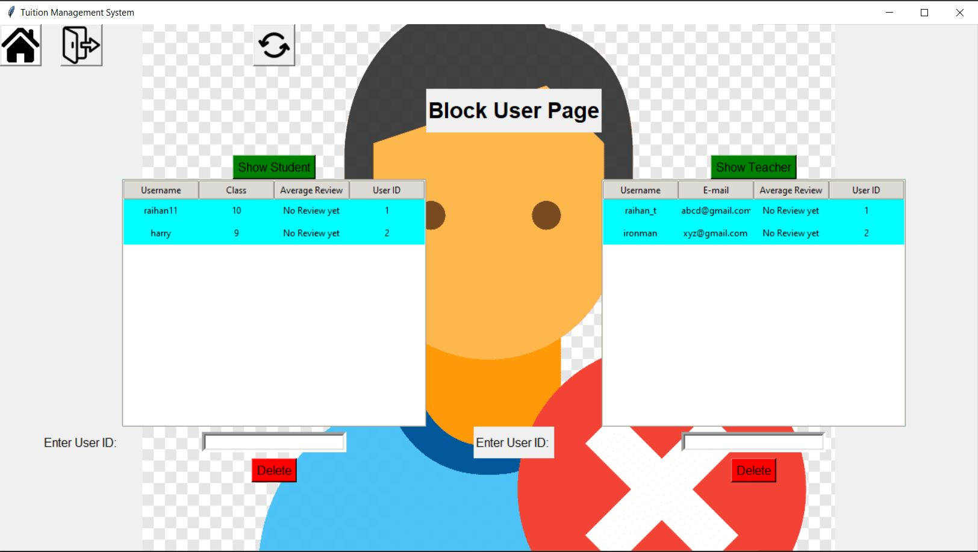
Block User Page
13
After click on block a user button
Show teachers button
Show students button
Input user ID and delete

Slide 14
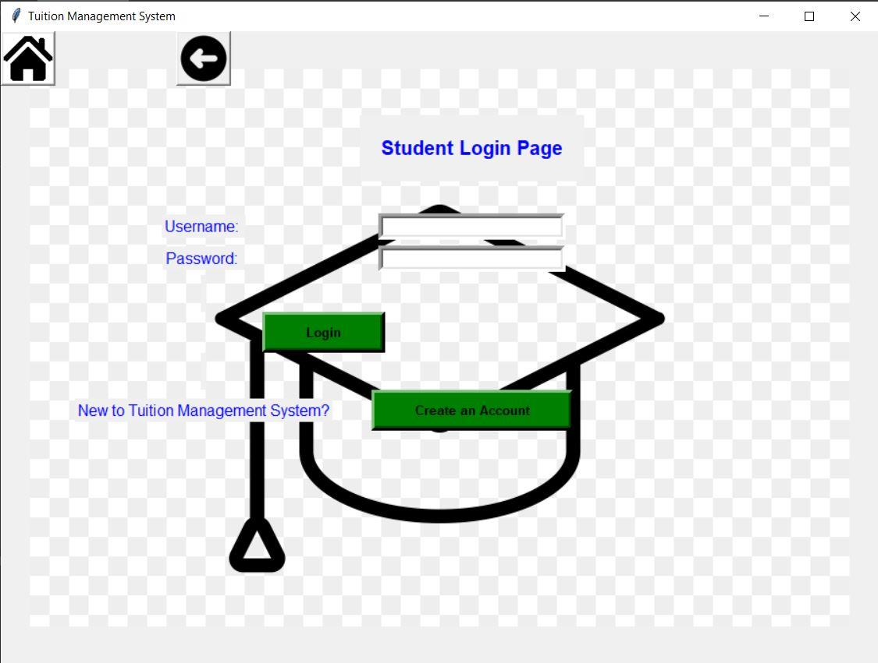
Student login page
14
After click student button
Input username and password to login
Or create an account

Slide 15
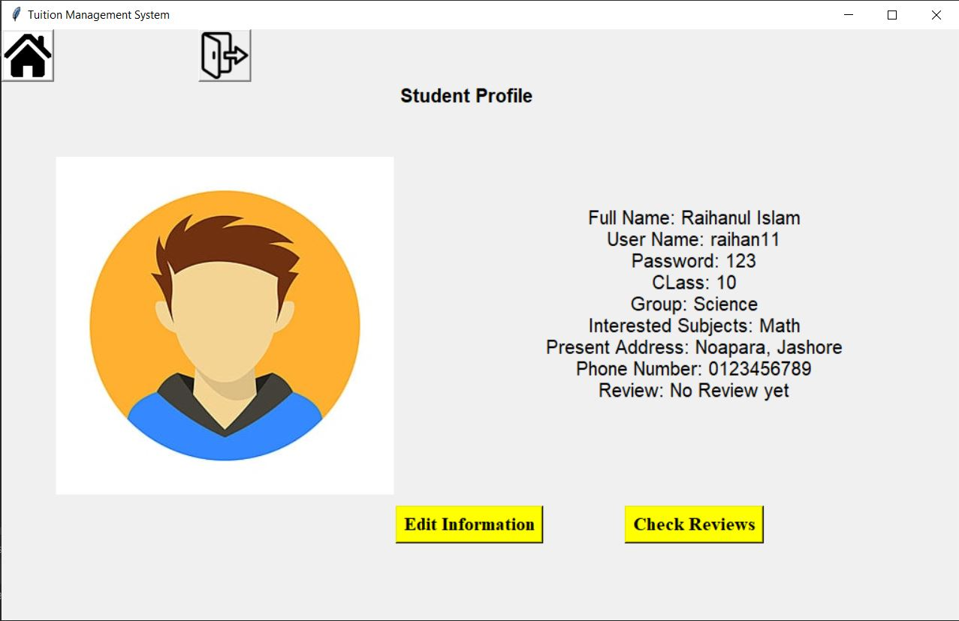
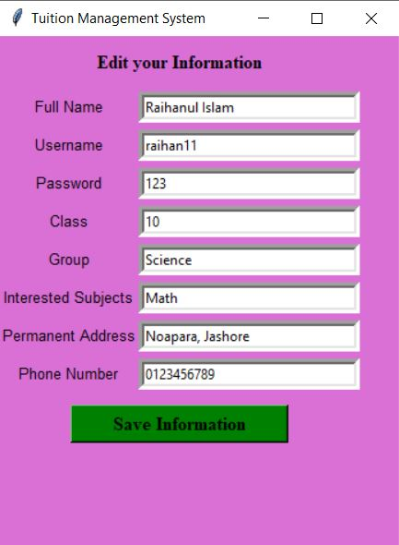
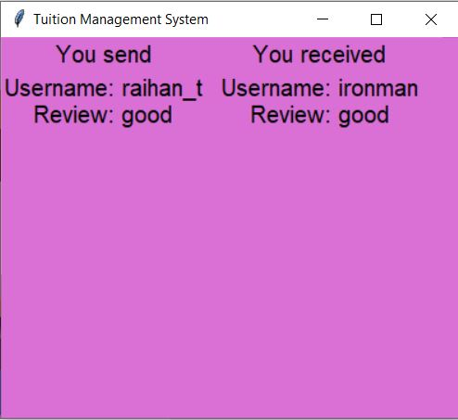
Student Profile
15
After student login
Edit Information
Check Reviews

Slide 16
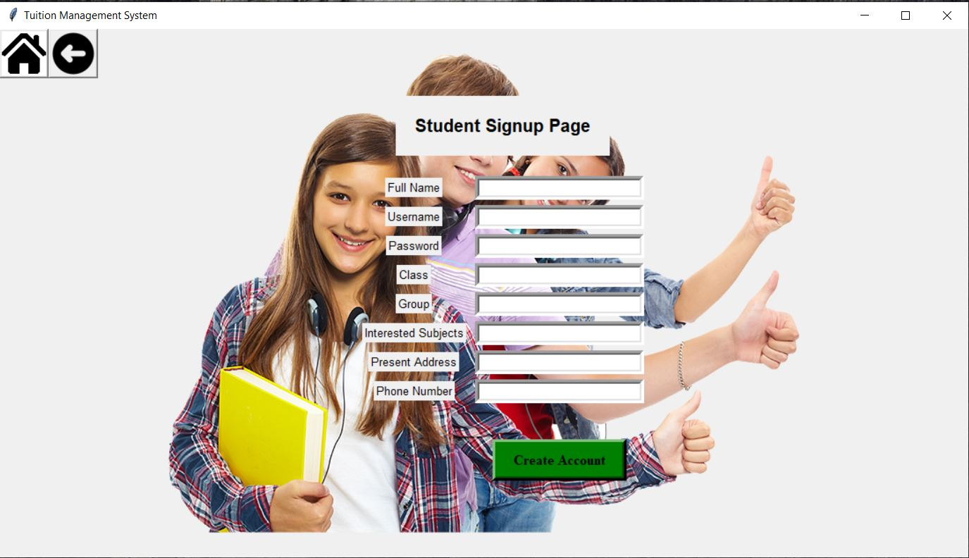
Student signup page
16
After click create an account button
Fill all information must
Crate a student account

Slide 17
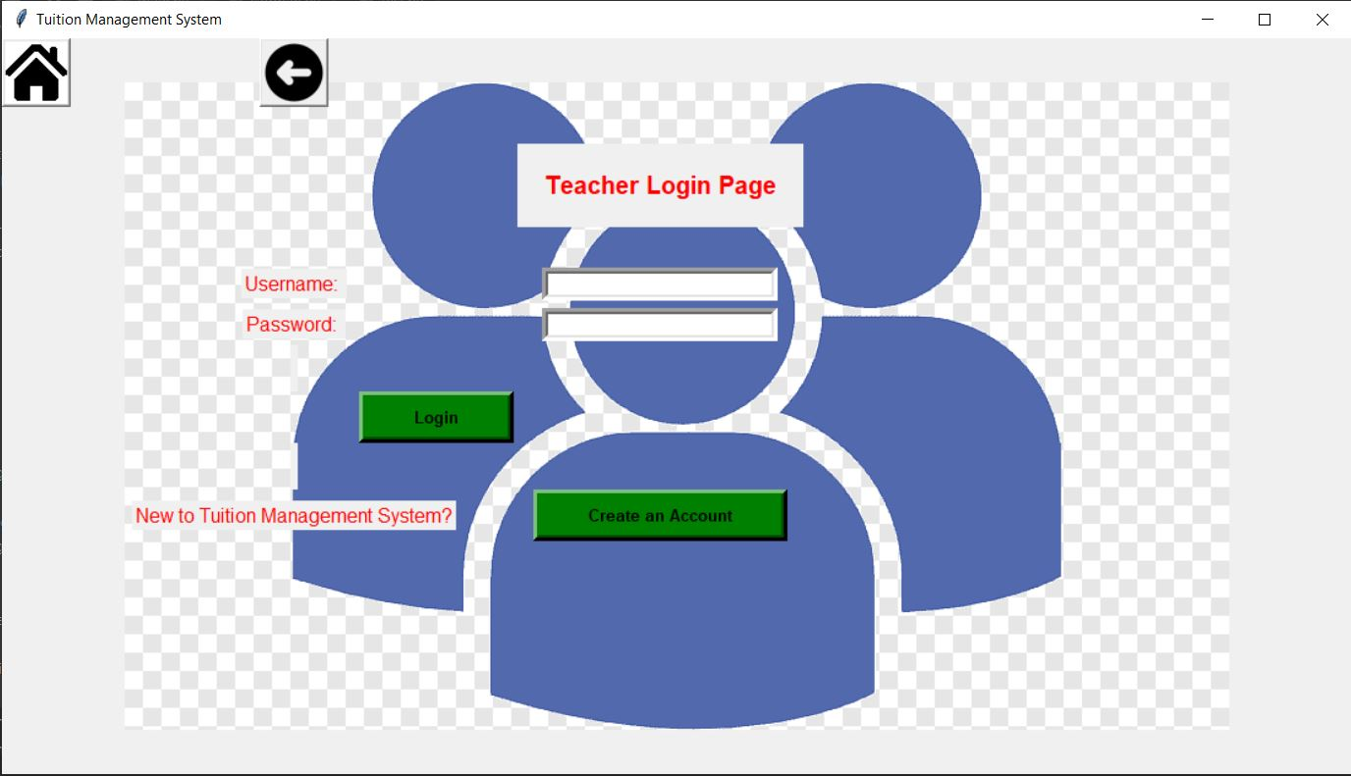
Teacher login page
17
After click teacher button
Input username and password to login
Or create an account

Slide 18
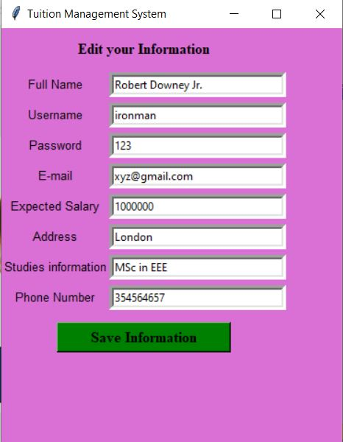
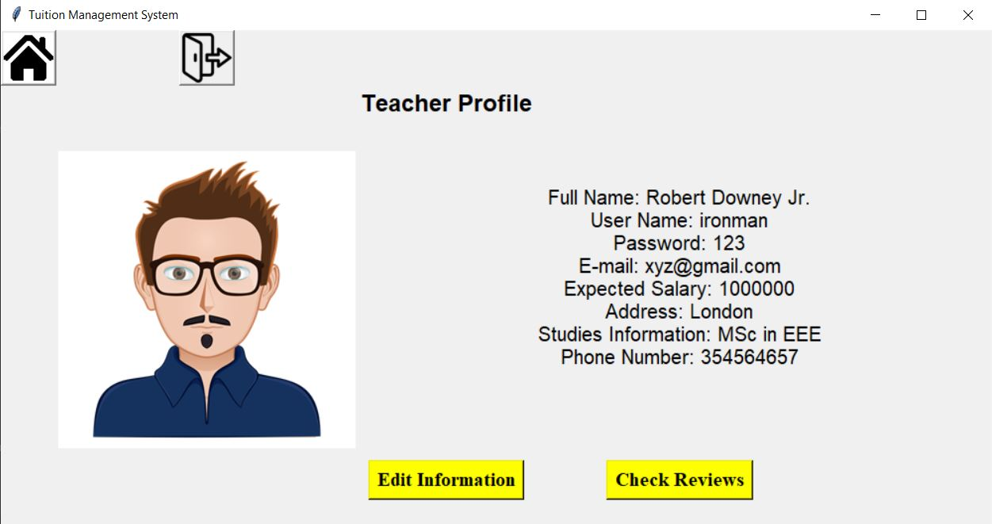
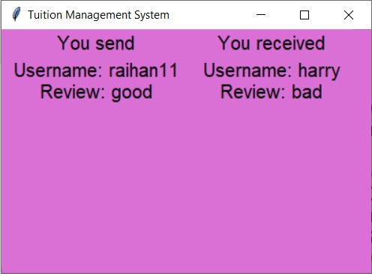
Teacher Profile
18
After teacher login
Edit Information
Check Reviews

Slide 19
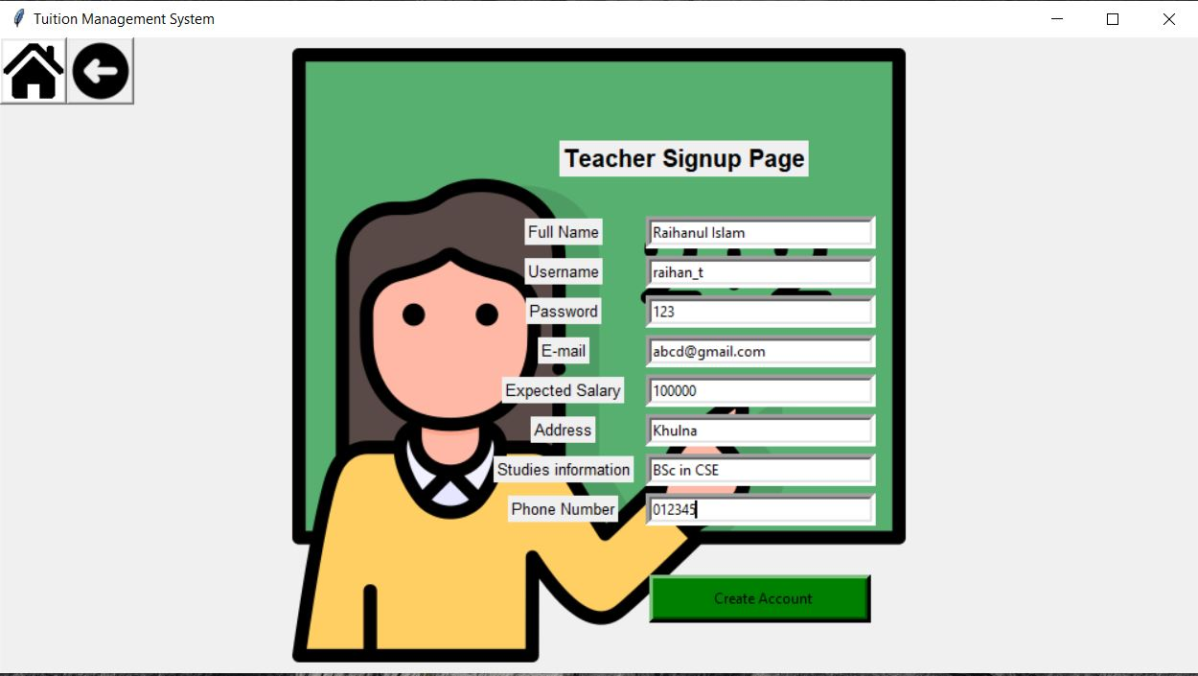
19
Teacher signup page
After click create an account button
Fill all information must
Crate a teacher account

Slide 20
1. SQlite3: Needed for Database of this software 2. Must be a python interpreter. 3. Tkinter: Used Tkinter standard GUI library.
20
Dependencies

Slide 21
Hope that everyone likes the software
21
Conclusion
Helpful to both teachers and students
Review system

Slide 22
Thank You
22

